Slide 1
E-JPPAP User Guide _ Supplier
George Zhou
March 2016

Slide 2
E-JPPAP Flow Chart _ Supplier
Resp.
Activities
PPAP Request Notification from Jabil
Complete the PPAP
Supplier
1). Fill in all information required.
2). Attach all documents required.
3). Internal review and submit the PPAP
Notification
Notification
System
N
1). Jabil team review the PPAP
PPAP Approved by Jabil
Jabil
Y
Finish/Notification
1). After Final approval, system will send a notification e-mail to supplier

Slide 3
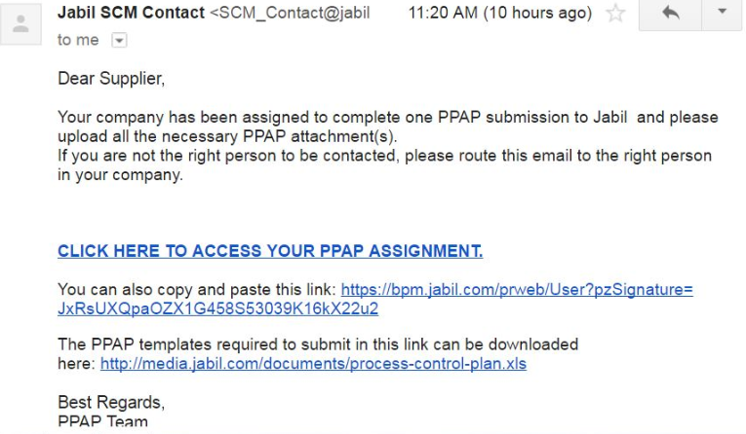
Receive The PPAP Request
Supplier will receive an e-mail like below:
Supplier can click the link to open the PPAP request.
Click the link to open the PPAP request.
Click the link to download the documents format.

Slide 4
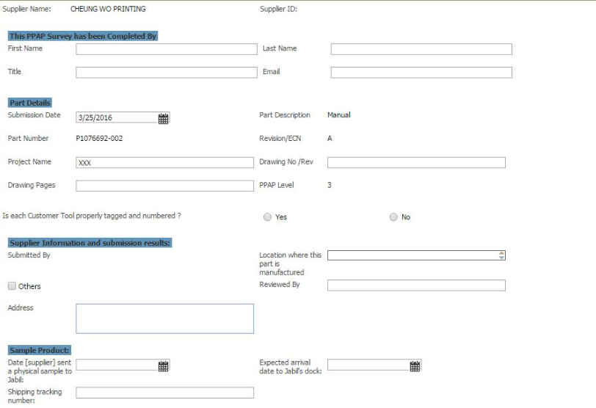
Fill In All Information Required
Complete supplier’s information
And the reviewer in supplier.
Complete the submitter’s information
If sample be sent to Jabil, fill
the sample tracking information here.
Complete the part’s information
If there are customer tool, select
whether they are tagged and numbered

Slide 5
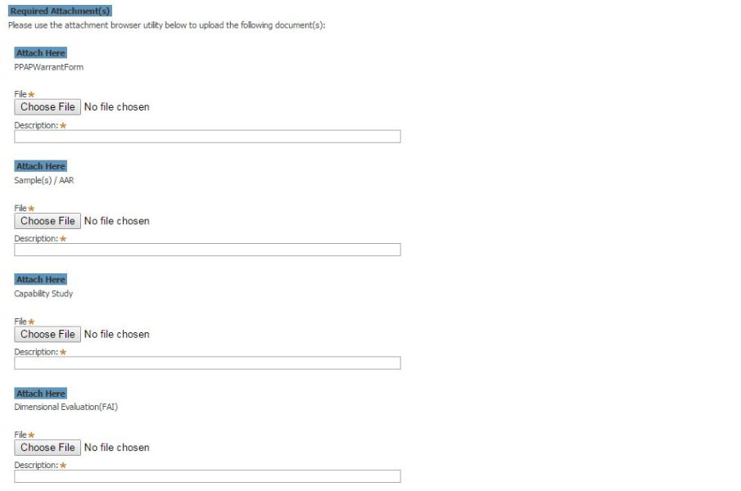
Attach The Documents Required
Click it to choose and upload the PSW document.
After PSW uploaded, the file name will come out automatically.
Repeat this step to choose and upload
all other attachments required.

Slide 6
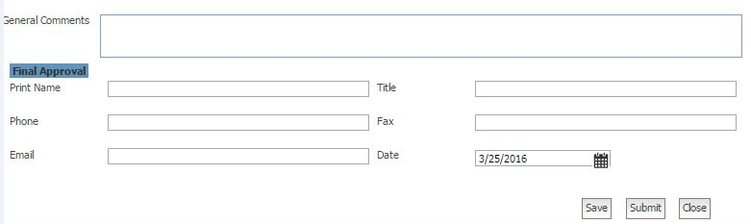
Complete The Form And Submit
Fill in the comments here, if applicable.
After all information completed,
and confirmed, click “Submit” to
submit to Jabil.
Or click “Save” in the input process
to save what has been done.
Or click “Close”, if you don’t want
to save what has been input.
Fill in the final approver’s information
and choose the approval date here.

Slide 7
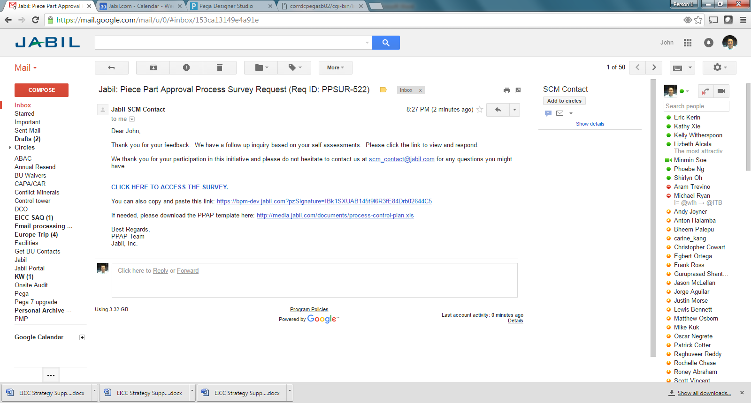
If PPAP Rejected—Mail Notification
If the PPAP is rejected by Jabil. One e-mail will be sent to supplier to require more information.
Click the link to open the PPAP request.
Click the link to download the documents format.

Slide 8
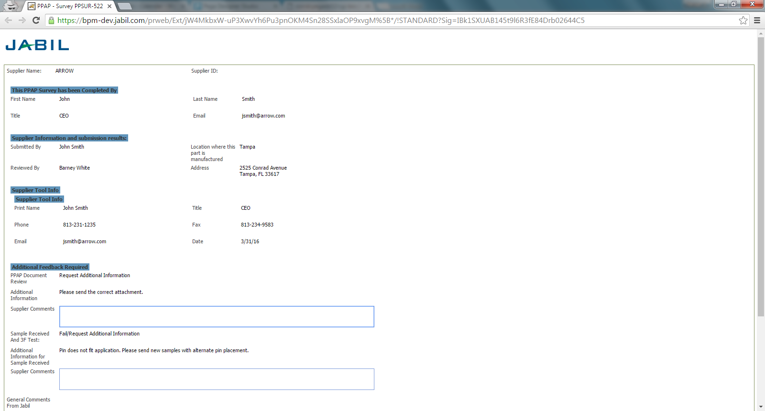
If PPAP Rejected—PPAP Case Information
Information of the rejected PPAP.

Slide 9
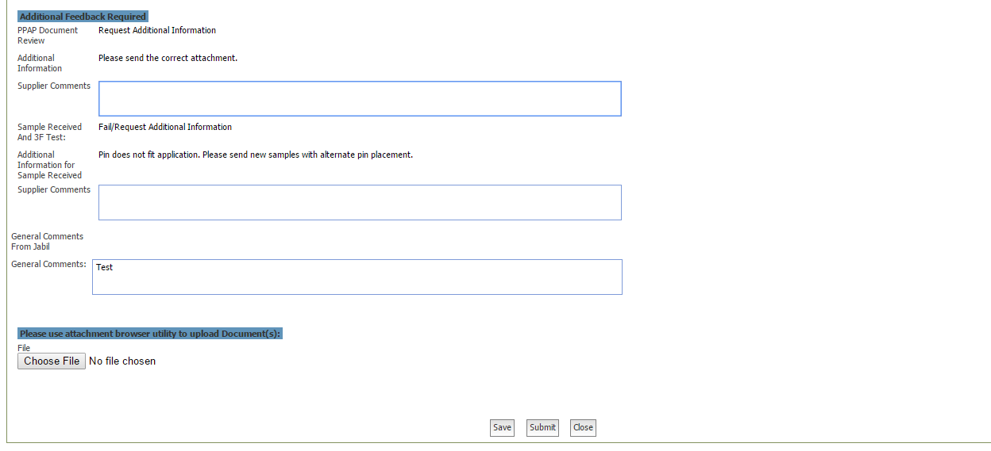
If PPAP Rejected—Additional Information Update
Additional Feedback Required.
Additional information requirement will be shown here.
Click here to upload the additional documents.
After all information updated, click here to submit. After submit, the system will remind Jabil to review it again.

Slide 10
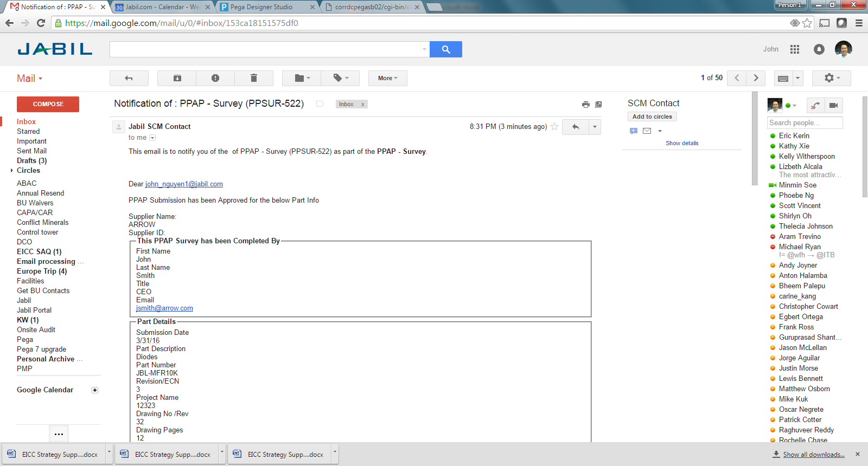
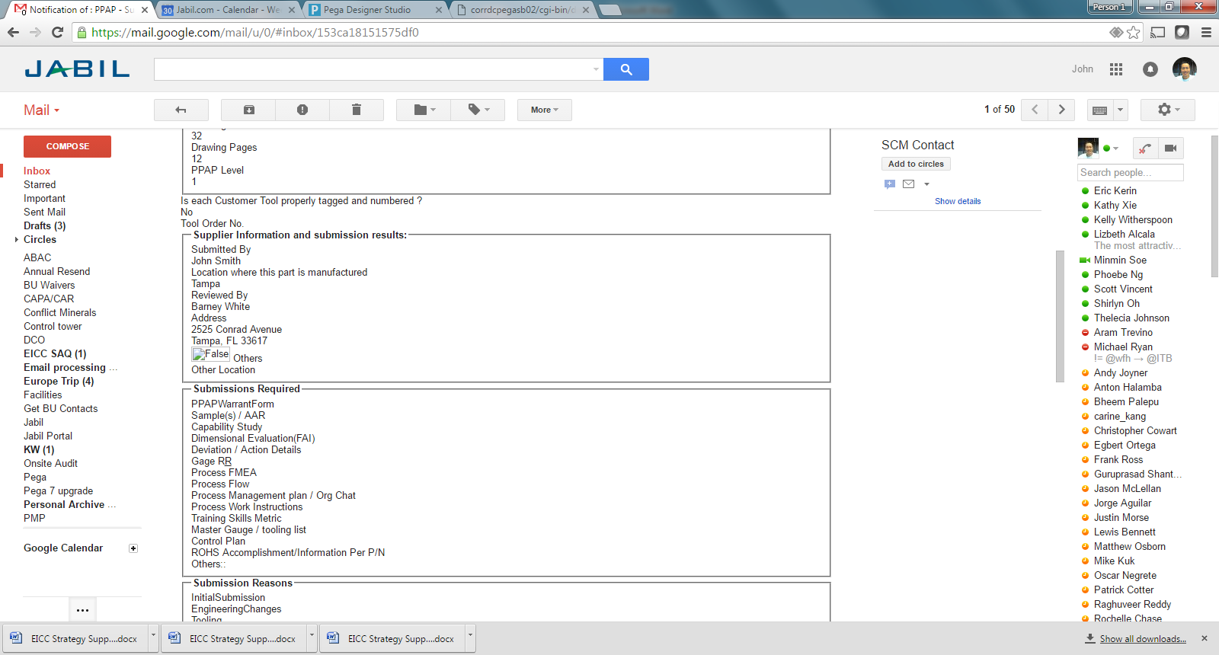
If PPAP Approved—Mail Notification
Once Final Approval is completed, e-mail which summarized the PPAP case will be sent to PPAP requester, owner, team member and supplier.

Slide 11
If PPAP Approved—Mail Notification
Once Final Approval is completed, e-mail which summarized the PPAP case will be sent to PPAP requester, owner, team member and supplier. (Continued)

Slide 12
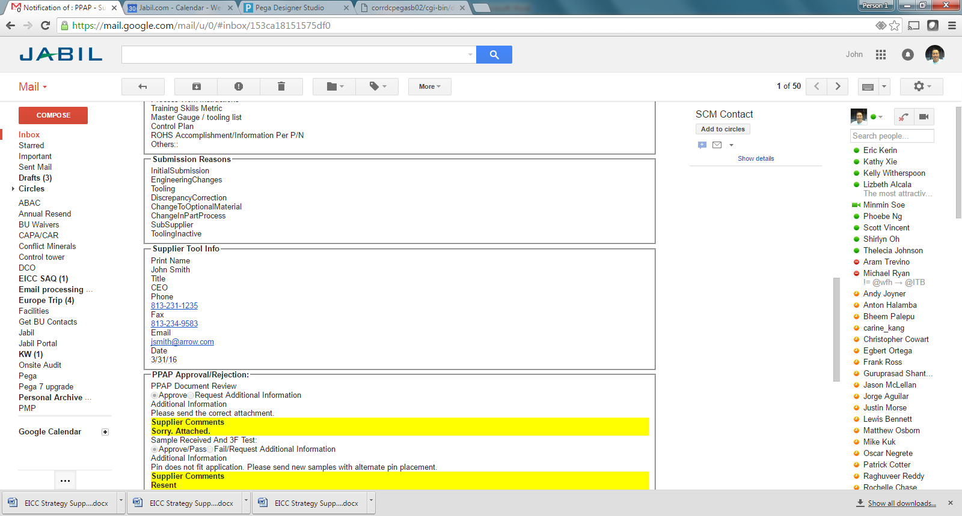
If PPAP Approved—Mail Notification
Once Final Approval is completed, e-mail which summarized the PPAP case will be sent to PPAP requester, owner, team member and supplier. (Continued)

Slide 13
Thank You

