Slide 1
SUPPLIER MATERIAL COMPLIANCE DECLARATION
Material Compliance Dept 6th April 2016

Slide 2
CONTENTS
Purpose
Material Compliance
  RoHS
  RoHS China
  REACH
  IMDS (Automotive)
  CAMDS (Automotive-China)
  Conflict Mineral (CMRT)
Jabil Material Declaration Process
Acceptance Reporting Format
Acceptance Criteria
Reference Links

Slide 3
WHAT IS PURPOSE?
To create awareness on Jabil Material Compliance.
To create better understand on Jabil Material Declaration Process.
To provide guideline on Jabil Material Declaration Reporting Format.

Slide 4

WHAT IS RoHS?
Restriction of Use of Hazardous Substances (RoHS) regulations limit or ban specific substances -- lead, cadmium, polybrominated biphenyl (PBB), mercury, hexavalent chromium, and polybrominated diphenyl ether (PBDE) flame retardants – in new electronic and electric equipment
RoHS aims to reduce substances which help to make those products easier and safer to treat and recycle when they become waste.

Slide 5
WHAT IS RoHS COMPLIANCE?
Six banned substances must not present in homogenous materials above the max concentration value, unless exempted :
The threshold must be calculated at the Homogeneous Material Level
Substances | Maximum Threshold level (homogenous)
Lead | 0.1% (1000 ppm)
Mercury | 0.1% (1000 ppm)
Hexavalent chromium – Cr(VI) | 0.1% (1000 ppm)
Cadmium | 0.01% (100 ppm)
Polybrominated biphenyl (flame retardants) –PBB | 0.1% (1000 ppm)
Polybrominated diphenyl ether (flame retardants) – PBDE | 0.1% (1000 ppm)

Slide 6

WHAT IS CHINA RoHS?
China RoHS (Restriction of Hazardous Substances), officially known as Administrative Measure on the Control of Pollution Caused by Electronic Information Products, is the official measure for pollution control in electronic products in China.
Applies to products imported into China for sale in China; and products manufactured in China and sold in China but excludes:
  Imported into China for re-export or manufacturing of products for export
  Components sold to an OEM who use in their own products.
  Hong Kong and Taiwan.

Slide 7
WHAT IS CHINA RoHS COMPLIANCE?
China’s RoHS is similar to the European version of RoHS which regulates cadmium, lead, hexavalent chromium, mercury and two brominated flame retardants, Polybrominated biphenyls (PBB) and Polybrominated diphenyl ether (PBDE).
Classification of Materials/ Maximum Permitted Values
The threshold must be calculated at the Homogeneous Material Level
Type | Maximum Threshold level (homogenous)
EIP - A | Each homogenoeus material in EIPs – All 0.1% by weight except cadmium at 0.01% (as EU RoHS)
EIP - B | Metal Plated Materials in each part of EIPs – The restricted substances shall not be added intentionally
EIP - C | Small components that cannot be separated (standard states < 4mm3, All 0.1% except cadmium at 0.01%

Slide 8

WHAT IS REACH?
Registration, Evaluation, Authorization and Restriction of Chemicals (REACH) is a European Union Regulation REACH addresses the production and use of chemical substances, and their potential impacts on both human health and the environment.
REACH covers use of chemical substances of very high concern (SVHC) because of their potential negative impacts on human health or the environment.

Slide 9
WHAT IS REACH COMPLIANCE?
Evaluate articles that contain substances of very high concern >0.1% by weight and totaling >1 ton/year
If the level of SVHC is at a higher level than 0.1% w/w then you have a duty to supply the recipient with sufficient information to allow safe use of that article.
If the level SVHC is at a higher level than 0.1w/w and it can be “intentionally” released and present in the article or preparation at greater than 1 tonne per annum, then the ECHA will need to be notified and the SVHC will need to be registered.

Slide 10
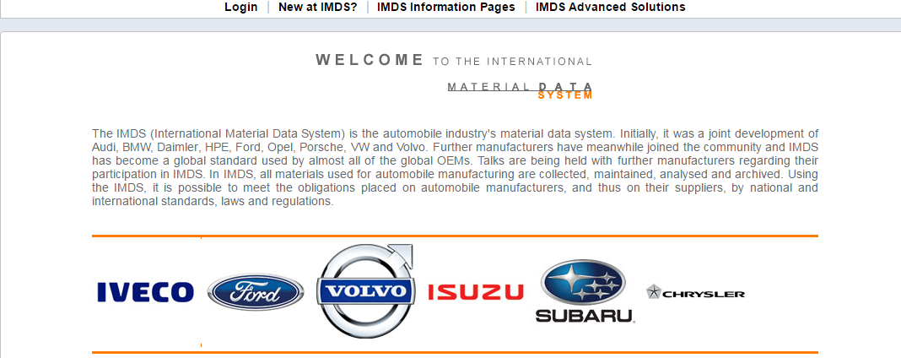
WHAT IS IMDS?
International Material Data System (IMDS) is a global data repository that contains information on materials used by the automotive industry.
In IMDS, all materials used for automobile manufacturing are collected, maintained, analysed and archived.
Using the IMDS, it is possible to meet the obligations placed on automobile manufacturers, and thus on their suppliers, by national and international standards, laws and regulations.

Slide 11

WHAT IS CAMDS?
China Automotive Material Data System (CAMDS) is a product data management platform for implementing the “Recycling and Reutilization Policy of Automotive Product”, carrying out the certification of recoverability rate and prohibited/restricted substance and improving the recoverability rate of China automotive material.
CAMDS provides a solution to trace the chemical composition of auto parts in the whole supply chain for China automotive industry and improves the scrapping and recycling level of component material of China auto products.

Slide 12
WHAT IS CONFLICT MINERAL?
Conflict Mineral is a U.S. Securities and Exchange Commission released rules for Section 1502 of the Dodd-Frank Wall Street Reform and Consumer Protection Act. These rules require U.S. publicly traded companies to trace the tantalum, tin, tungsten and gold (3TG) in their products and disclose whether they came from "conflict mines" in the Democratic Republic of the Congo.
Companies subject to the SEC reporting requirement would be required to disclose whether the minerals used in their products originated in the DRC or adjoining countries (as defined above).

Slide 13
JABIL MATERIAL DECLARATION PROCESS FLOW
Upon MCR request/ PO requirement/ site purchasing requirement
Suppliers are required to prepare material declaration documents for every requested part numbers within 2 weeks. *
Suppliers submit the completed material declaration documents to respective individual requester / Jabil group email, environmental_compliance@jabil.com or Conflict_Minerals@jabil.com or online portal (IMDS& CAMDS).
Material Declaration Closed
Data verification process
Accept
Reject
Supplier revise the material declaration document based on the comment within 3 to 5 days
Note : (*) Subjected to project requirement

Slide 14
ACCEPTANCE REPORTING FORMAT
Requirement | Reporting Format | Notes
RoHS | ECC / IPC-1752-2 Class 6 | Full Material Composition Declaration
CHINA RoHS | ECC / IPC-1752-2 Class 6 | Full Material Composition Declaration
REACH | ECC / IPC-1752-2 Class 6 | Full Material Composition Declaration
IMDS | IMDS Portal | http://www.mdsystem.com/imdsnt/startpage/index.jsp
CAMDS | CAMDS Portal | http://cuc2.camds.org/camds/mainpage.action?request_locale=en
Conflict Mineral (CMRT) | CFSI_CMRT (Latest Revision) | http://www.conflictfreesourcing.org/

Slide 15
ACCEPTANCE CRITERIA
Reporting Format | Acceptance Criteria
General | Validity for all declared documents must within 2 years. Declared in Manufacturing Part Number (MPN). All declared documents language must be English, except standard template with language option.
ECC-ElectronicComplianceConnect | No Error and Warning Message. Measured Part Weight per Length/Area/Volume Unit must be “Each” Raw Material Submission default to “No”. RoHS Exemption must include for RoHS banned substances Must certify and export to mcc. format.
IPC-1752-2 Class 6 | Form type must choose “Request/Reply”. Declaration class must be “Class 6” My Supplier ID and “red” highlighted Existing Field must fill-in. Unit type must be “Each” Manufacturing Process Information must include, if applicable. Declaration Type always “Simplified” or “Detailed” Must include Digital Signature. Homogenous Material Name must be unique. Choose the correct substance level for JIG A/B. Exclude PPM.

Slide 16
ACCEPTANCE CRITERIA
Reporting Format | Acceptance Criteria
Certificate of Compliance (CoC) | Referencing the relevant regulation. Contain a definitive Compliance statement. Provide the applicable exemption if any. State the part number or part family under scope clearly. In manufacturer letter head with manufacturer logo. Preferably with an authorized signature.
IMDS | Material name and classification must be unambiguous/descriptive in line with IMDS Recommendation 001. No Error and Warning Message. Do not declare using SINGLE substance per material.
CAMDS
Conflict Mineral (CMRT) | “Yellow” highlighted field must be fill-in. Declaration document must be declared by manufacturers. Smelter info must be available, if 3 TG exist in declared products. For declaration with “product” scope, ensure “Product” tab is fill in. Check on “Checker” tab to ensure all required fields are in green before submit.

Slide 17
REFERENCE LINKS
Requirement | Web link
RoHS | http://ec.europa.eu/environment/waste/rohs_eee/index_en.htm http://www.rohsguide.com/
China RoHS | http://www.chinarohs.com/
REACH | http://ec.europa.eu/environment/chemicals/reach/reach_en.htm http://echa.europa.eu/chem_data/candidate_list_table_en.asp
IMDS | http://www.mdsystem.com/imdsnt/startpage/index.jsp
CAMDS | http://cuc2.camds.org/camds/mainpage.action?request_locale=en
Conflict Mineral | http://www.conflictfreesourcing.org/
Jabil Supplier Portal | http://www.jabil.com/portals/suppliers/
Jabil BaRS requirement | http://www.jabil.com/portals/bars-requirement.html
Jabil Conflict Mineral Policy | http://www.jabil.com/portals/conflict-minerals-policy.html

Slide 18
THANK YOU

